Slide 1
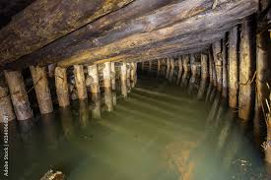
The Rule in Rylands v Fletcher
John Murphy

Slide 2
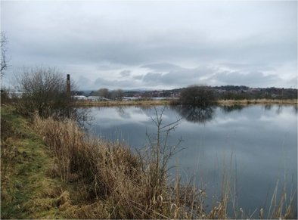
I Introductory Issues
Limited Application
The tort is of limited practical application in the modern era. It was developed before we had a general tort of negligence.
But nowadays, many of the relevant cases would be actionable in negligence (as happens in Australia!).
In Australia, the action has been formally subsumed within the law of negligence.
A Strict Liability Tort
Rylands v Fletcher (1868) LR 3 HL 330
“The person who for his own purposes brings on his land and keeps and collects
there anything likely to do mischief if it escapes, must keep it in at his peril
and is prima facie answerable for all the damage which is the natural consequence
of its escape”. (Blackburn J)
In House of Lords, this dictum was accepted but qualified: D must be engaged in a “non-natural” use of his land.
Transco plc v Stockport MBC [2004] 2 AC 1
“Bearing in mind the historical origins of the rule … its effect is to impose liability in the absence of negligence for an
isolated occurrence”. (Lord Bingham).

Slide 3
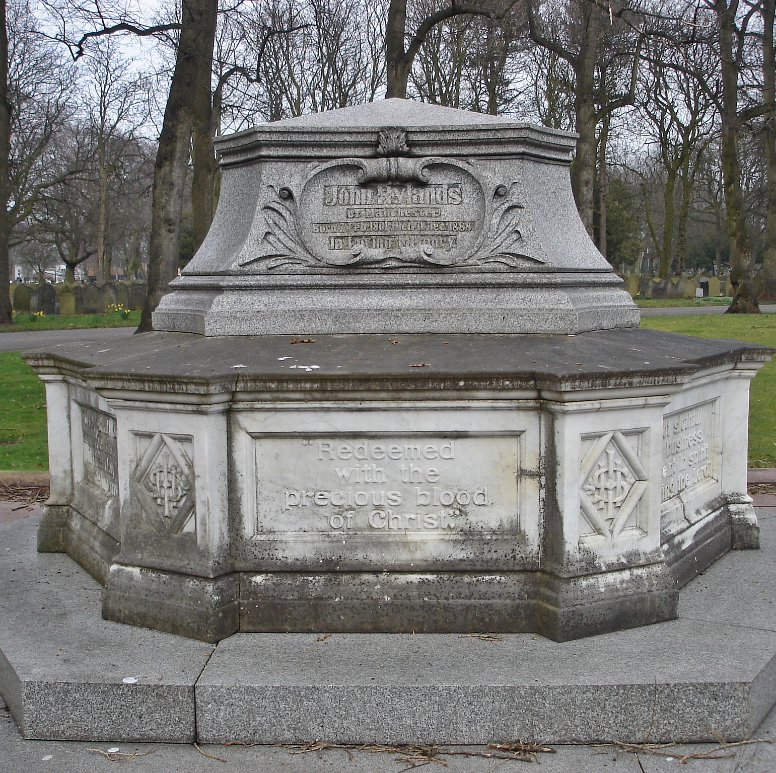
And here is the Rylands Memorial in Manchester
He left a lot of money to various charities as well as Manchester University (my former employer) has its library named after John Rylands. (He was the wealthiest textile engineer in Manchester.)

Slide 4
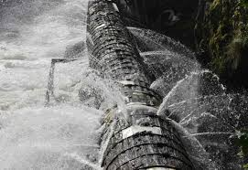
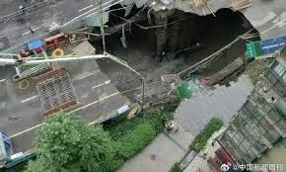
II Elements of the Rule
A. “Non‑natural Use”
The definition of non‑natural use remains elusive. And the best definition, for a long time, came from a case reported in 1913.
Rickards v Lothian [1913] AC 263
“[It is]some special use bringing with it increased danger to others, and must not merely be
the ordinary use of land or such use as is proper for the general benefit of the community”.
(Lord Macnaghten).
Since then, Rickards has been endorsed with a little more elaboration.
Transco plc v Stockport Metropolitan Borough Council [2003] UKHL 61
“[T]he rule in Rylands v Fletcher is engaged only where the defendant’s use is shown to be
extraordinary or unusual”. (Lord Bingham)
Yet, Lord Bingham (a) doubted whether it could be a direct parallel to unreasonable user in private nuisance, and (b) said that the key was whether the use was ordinary in time and place.

Slide 5

1. Non-natural Use Decided Contextually: A Question of Fact and Degree Read v Lyons [1947] AC 156 “it was not non-natural to use land in war-time for the manufacture of explosives”. (Lord Macmillan) Wayfoong Credit Ltd v Tsui Siu Man Plastics [1984] HKLR 259 “There was little actual evidence as to the character of the neighbourhood, but we do know that the defendant occupied a flatted factory in an industrial building, and we may take judicial notice that Kwun Tong is by no means a purely residential area”. (Cons JA) Wong Ching Chi v Full Yue Bleaching and Dyeing Co Ltd [1994] 3 HKC 606 “Ultimately, the question of whether the use was natural or not arises as one of fact and degree in each case … In the present case, it has to be borne in mind that the building was an industrial building. But even then, we are confronted by 21 tanks and a pool sunk into the floor. In my view, the user here was non-natural”. (Bokhary J)

Slide 6
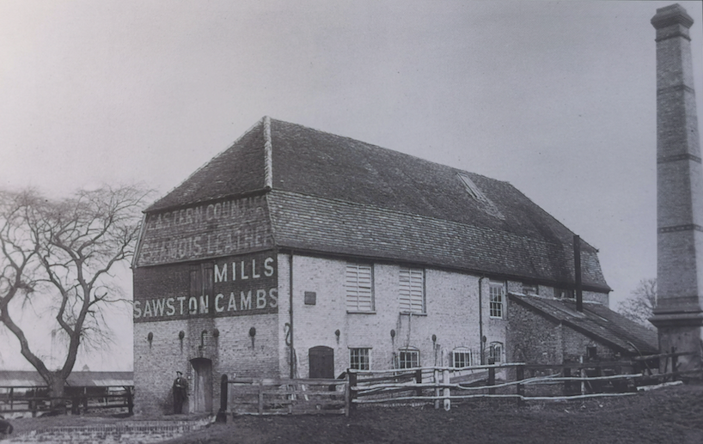

2. Non-natural use: the Role of Social Utility? In Rickards, Lord Moulton hinted at a connection between the social utility of D’s enterprise and the question of whether there had been a natural use. But if it can count at all, the connection must not be overstated: Cambridge Water v Eastern Counties Leather (supra) “I myself ... do not feel able to accept that the creation of employment as such, even in a small industrial complex, is sufficient of itself to establish a particular use as constituting a natural or ordinary use of land”. (Lord Goff) In truth, the law as it stands does not allow us to say just how far one can take the notion that employment creation will help D establish a natural use of land. All that is clear is Lord Goff’s obvious lack of enthusiasm in this respect.

Slide 7


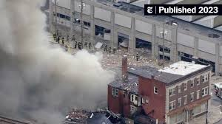
B. “D Brings onto his Land and Keeps/Collects there...” The difficulty with this element of the rule is what is meant by “brings onto his land and keeps or collects there”.
Giles v Walker (1890) 24 QBD 656
C. Escape
There must be an escape from D’s land.
Read v Lyons [1947] AC 156
Plus, the thing that escapes must be the thing brought onto the land.
Chung Wah Steel Ltd v Chan Kwong Kwan [2013] HKCU 2118
“The ‘thing’ brought onto the defendant’s premises was second-hand furniture, electrical appliances and various other miscellaneous items… [But] [t]he items did not escape. What escaped was the fire”. (Wilson Chan J)

Slide 8


D. “Liable to do Mischief if it Escapes” It is clear that the thing need not be dangerous in itself. Recall that water in Rylands itself was not per se dangerous. It was, though, able to do damage upon its escape in vast quantities was relevant. ACL Electronics (HK) Ltd v Bulmer Ltd [1992] 1 HKC 133 E. Protected Interests A key question concerns the range of protected interests covered by the Rylands rule. 1. Land Rylands v Fletcher itself makes clear that damage to land supports an action.

Slide 9


2. Chattels Jones v Festiniog Rly (1868) LR 3 QB 733 (chattels) Wong Ching Chi v Full Yue Bleaching and Dyeing Co Ltd [1994] 3 HKC 606 3. Personal Injury Hale v Jennings [1938] 1 All ER 579 Cf Transco plc v Stockport Metropolitan Borough Council [2003] UKHL 61 NB 1 HL in Transco said that the rule in Rylands was a sub-branch of the law of private nuisance and that, therefore, it ought now to be confined to damage to land (and interests in land). NB 2 The HL saying this was NOT material to turning down the claim in Transco: therefore obiter. 4. Remoteness of Damage Cambridge Water (above)

Slide 10

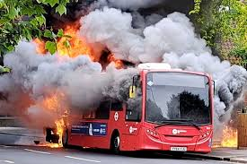
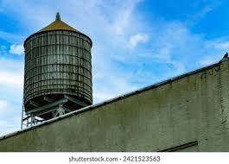
III Defences As in private nuisance, there are several recognised defences which D might raise. A. Act of God Nichols v Marsland (1876) 2 Ex D 1 “[D] can excuse himself by shewing that the escape was owing to the plaintiff’s default; or perhaps that the escape was the consequence of vis major, or the act of God”. (Mellish LJ) B. Unforeseeable act of a “Stranger” Perry v Kendricks [1956] 1 WLR 85 “an occupant of land cannot be held liable under the rule if the act bringing about the escape was the act of a stranger, and not any act or omission of the occupier himself or his servant or agent, or any defect, latent or patent, in the arrangements made for keeping the dangerous thing under control”. (Jenkins LJ) C. Consent of the Claimant Carstairs v Taylor (1871) LR 6 Ex 217 “here the plaintiffs must be taken to have consented to this collection of the water which was for their own benefit … [So D] can only be liable if he was guilty of negligence”. (Bramwell B)

Slide 11

D. Statutory Authority This operates in the same way we saw in the context of nuisance. Green v Chelsea Waterworks (1894) 70 LT 547 “Here the defendants were only doing what they were authorised to do … and, as they were not guilty of negligence, they are not liable for damage”. (Lindley LJ) E. Default of Claimant It was said in R v F that if C was the cause of the escape, then C cannot claim.

